Slide 1
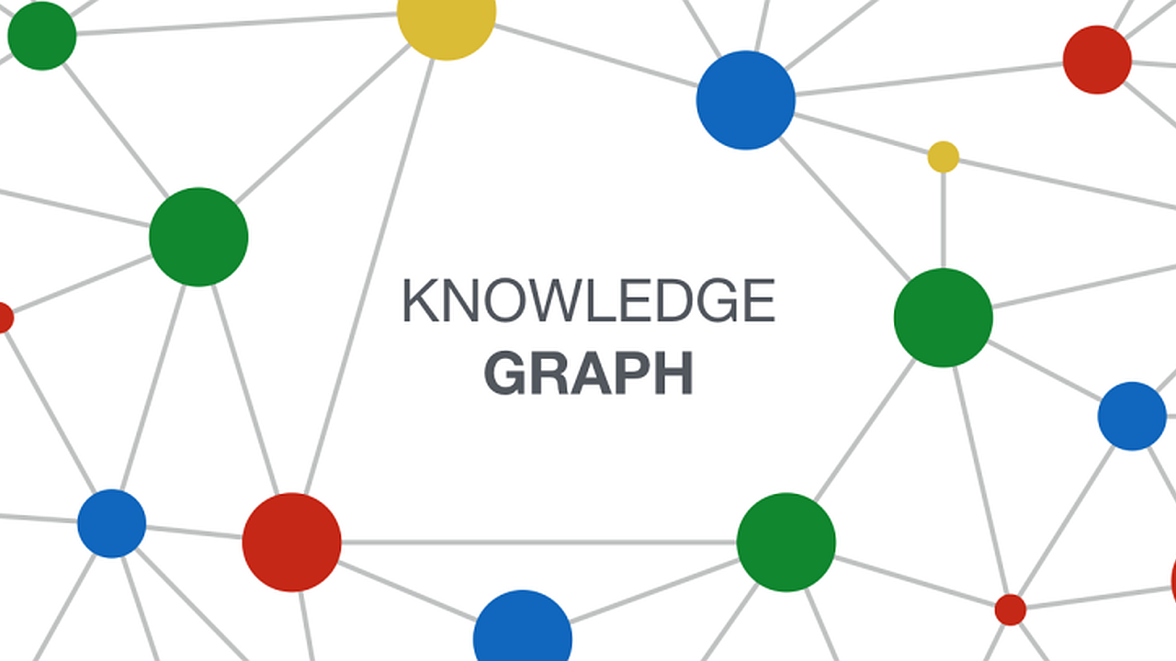
Optimizing KGQA Systems: A Systematic Comparative Study of Negative Sampling Strategies in KGE Models
Medhasweta Sen, Nina Ebensperger, Nayaeun Kwon
2024 Capstone Project
Notes:
Sen

Slide 2
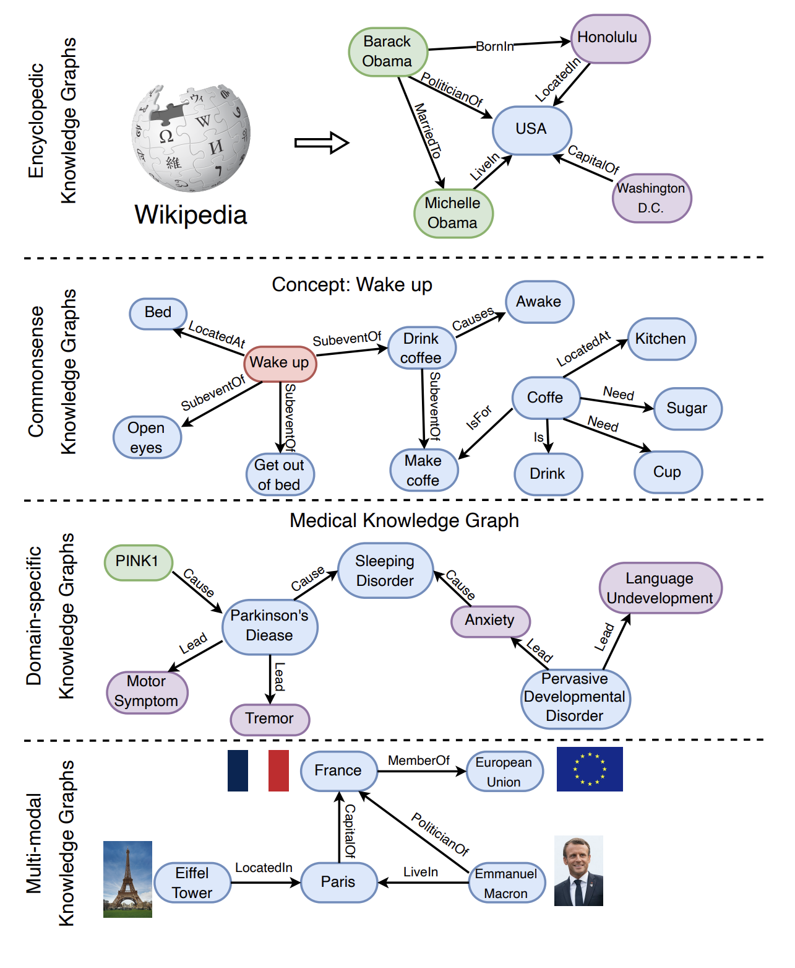
Knowledge Graphs
Encyclopedic Knowledge Graphs
Commonsense Knowledge Graphs
Domain-specific Knowledge Graphs
Multi-modal Knowledge Graphs
Notes:
Sen

Slide 3

Knowledge Graph Embedding (KGEs)
Why do we need KGE?
How do we compute KGEs?
Notes:
Sen
We can use Knowledge Graph Embedding technique to represent entities and relationships in a knowledge graph in a continuous vector space.
There are two prominent kge methods: distmult, complex.
In DistMult, each triple in the knowledge graph is represented as a low-dimensional vector. Through the vector, we can calculate the score, which reflect how well the embeddings of the entities and relation align with each other. They get score by taking the dot product of the embeddings of the head and tail entities after applying a diagonal matrix to the head entity's embedding.
It adjust the embeddings of entities and relations to assign higher scores to true triples and lower scores to false or implausible triples. This process involves optimizing the embeddings using a margin ranking loss to maximize the margin between the scores of positive relation triples and negative samples.
Although it’s simple, scalable, and computational efficient, this method can only capture symmetric relationships using diagonal matrices as the head and tail, so it is not suitable for general knowledge graphs.
Complex extends DistMult by utilizing complex embeddings such as real and imaginary parts to handle asymmetric relationships. This not only reduces computational complexity but also improves entity representation capabilities. The score for a triple in complex is computed by taking the conjugate dot product between the embeddings of the head and tail entities, and the embedding of the relation.

Slide 4
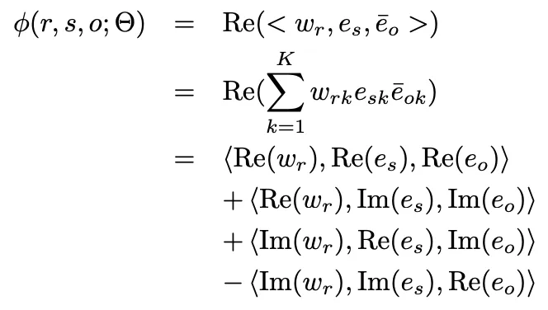
ComplEx Embeddings:
Scoring Function:
Properties:
✅ Symmetry
✅ 1-to-N/N-to-1
❌ Composition
✅ Antisymmetry
✅ Inverse
Notes:
Sen
We can use Knowledge Graph Embedding technique to represent entities and relationships in a knowledge graph in a continuous vector space.
There are two prominent kge methods: distmult, complex.
In DistMult, each triple in the knowledge graph is represented as a low-dimensional vector. Through the vector, we can calculate the score, which reflect how well the embeddings of the entities and relation align with each other. They get score by taking the dot product of the embeddings of the head and tail entities after applying a diagonal matrix to the head entity's embedding.
It adjust the embeddings of entities and relations to assign higher scores to true triples and lower scores to false or implausible triples. This process involves optimizing the embeddings using a margin ranking loss to maximize the margin between the scores of positive relation triples and negative samples.
Although it’s simple, scalable, and computational efficient, this method can only capture symmetric relationships using diagonal matrices as the head and tail, so it is not suitable for general knowledge graphs.
Complex extends DistMult by utilizing complex embeddings such as real and imaginary parts to handle asymmetric relationships. This not only reduces computational complexity but also improves entity representation capabilities. The score for a triple in complex is computed by taking the conjugate dot product between the embeddings of the head and tail entities, and the embedding of the relation.

Slide 5
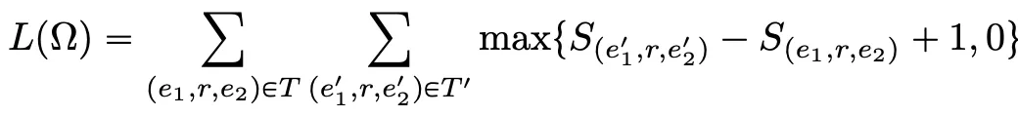
DistMult Embeddings:
Scoring Function:
Properties:
✅ Symmetry
✅ 1-to-N/N-to-1
❌ Composition
❌ Antisymmetry
❌ Inverse
Notes:
Sen
We can use Knowledge Graph Embedding technique to represent entities and relationships in a knowledge graph in a continuous vector space.
There are two prominent kge methods: distmult, complex.
In DistMult, each triple in the knowledge graph is represented as a low-dimensional vector. Through the vector, we can calculate the score, which reflect how well the embeddings of the entities and relation align with each other. They get score by taking the dot product of the embeddings of the head and tail entities after applying a diagonal matrix to the head entity's embedding.
It adjust the embeddings of entities and relations to assign higher scores to true triples and lower scores to false or implausible triples. This process involves optimizing the embeddings using a margin ranking loss to maximize the margin between the scores of positive relation triples and negative samples.
Although it’s simple, scalable, and computational efficient, this method can only capture symmetric relationships using diagonal matrices as the head and tail, so it is not suitable for general knowledge graphs.
Complex extends DistMult by utilizing complex embeddings such as real and imaginary parts to handle asymmetric relationships. This not only reduces computational complexity but also improves entity representation capabilities. The score for a triple in complex is computed by taking the conjugate dot product between the embeddings of the head and tail entities, and the embedding of the relation.

Slide 6
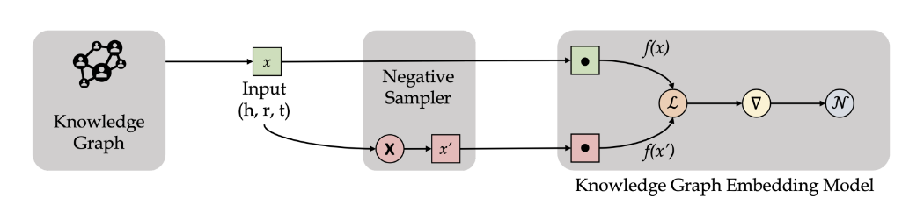
Negative Sampling in KGE Generation
Methods:
Uniform Sampling: Random replacement of head or tail entities.
Random Corrupt Sampling: Extends uniform sampling by also corrupting relations.
Batch NS: Reuses samples within the same mini-batch for efficiency.
Notes:
Sen

Slide 7
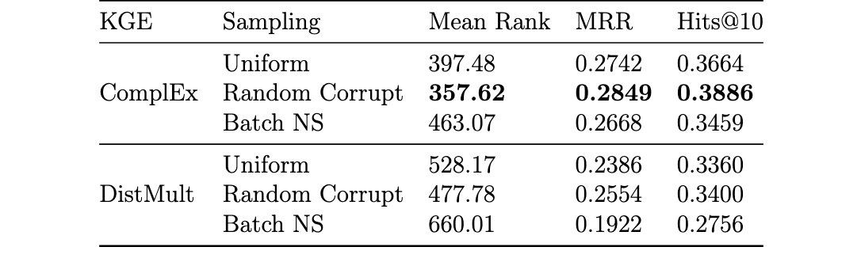
Performance of KGEs with varying Negative Sampling Techniques
Notes:
Sen
So, this is the results part.
This is the result for the best knowledge graph embedding. As Sen explained, we used complex and distmult,

Slide 8
Why do we need Embed KGQA?
Notes:
Nina
EmbedKGQA is designed to enhance question-answering systems that work with knowledge graphs. By converting the complex relationships into embeddings.
Additionally, knowledge graphs often have gaps or missing links between data points, "sparse." EmbedKGQA helps address this issue by using embeddings to fill in these gaps, making it easier for the system to understand and make connections. This capability is crucial for efficiently retrieving information and providing accurate answers to complex questions
EmbedKGQA aims to make these systems not only faster but also more accurate at finding the right answers.

Slide 9
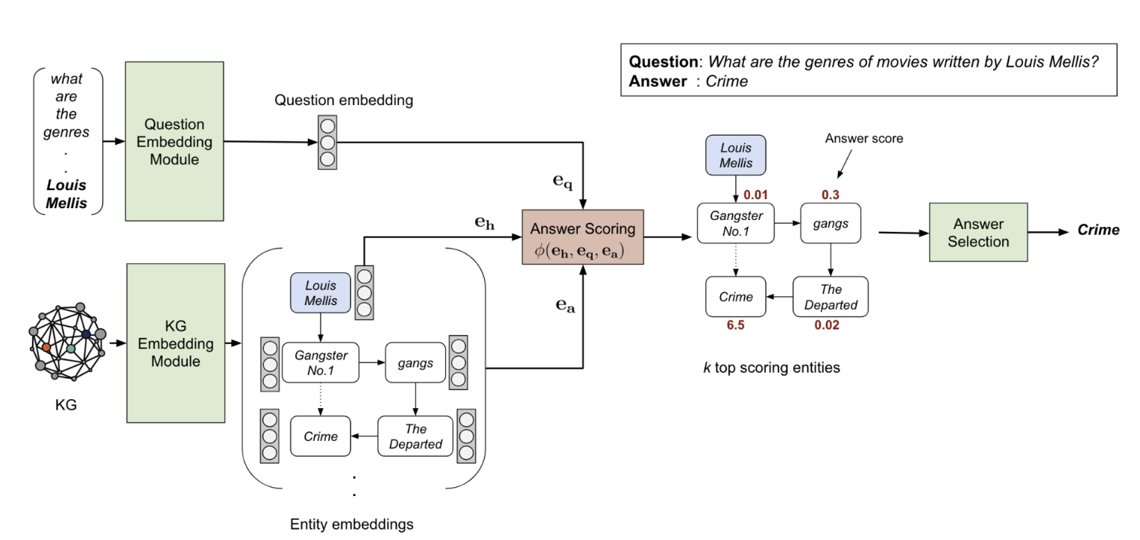
EmbedKGQA

Slide 10
How do we compute KGEs?
Notes:
Core Components: Consists of three main modules—KG Embedding Module, Question Embedding Module, and Answer Selection Module.

Slide 11
EmbedKGQA: KG Embedding Module
Notes:
Nina
Foundational Role: Transforms KG entities and relations into vector spaces
Techniques Used: ComplEx and DistMult for high-dimensional embeddings
Key Aspects:
Captures intricate relationships within the KG
Encodes attributes and types for a rich entity representation
ComplEx Embeddings: Handles complex relationships using complex vector spaces
DistMult Embeddings: Simplifies embeddings with real-valued vectors for symmetric relations
We can use Knowledge Graph Embedding technique to represent entities and relationships in a knowledge graph in a continuous vector space.
There are two prominent kge methods: distmult, complex.
In DistMult, each triple in the knowledge graph is represented as a low-dimensional vector. Through the vector, we can calculate the score, which reflect how well the embeddings of the entities and relation align with each other. They get score by taking the dot product of the embeddings of the head and tail entities after applying a diagonal matrix to the head entity's embedding.
It adjust the embeddings of entities and relations to assign higher scores to true triples and lower scores to false or implausible triples. This process involves optimizing the embeddings using a margin ranking loss to maximize the margin between the scores of positive relation triples and negative samples.
Although it’s simple, scalable, and computational efficient, this method can only capture symmetric relationships using diagonal matrices as the head and tail, so it is not suitable for general knowledge graphs.
Complex extends DistMult by utilizing complex embeddings such as real and imaginary parts to handle asymmetric relationships. This not only reduces computational complexity but also improves entity representation capabilities. The score for a triple in complex is computed by taking the conjugate dot product between the embeddings of the head and tail entities, and the embedding of the relation.

Slide 12
EmbedKGQA: Question Embedding Module
Notes:
Nina
Process Overview: Converts questions for comparison with KG embeddings
Steps Involved:
Initial high-dimensional vector creation using RoBERTa or SentenceTransformer
Refinement through a feedforward neural network
Projection into the complex vector space for alignment with KG embeddings
The Question Embedding Module in EmbedKGQA handles the conversion of natural language questions into a format that can be compared with the embedded entities and relations of the knowledge graph. This process typically involves several steps:
Initial Embedding: A pre-trained language model like RoBERTa is used to transform the text of the question into an initial high-dimensional vector (768 dimensions). This vector captures the syntactic and semantic nuances of the question.
Feedforward Neural Network: The initial vector is then passed through four fully connected linear layers with ReLU activation. These layers serve to refine and adapt the vector, ensuring it aligns well with the dimensions and characteristics of the KG embeddings.
Projection into Complex Space:Finally, the output from the feedforward network is projected into the same complex vector space as the KG embeddings. This ensures that the question embeddings can be directly compared with entity and relation embeddings using the scoring function in subsequent processes.
Integration of SentenceTransformer: The SentenceTransformer is utilized within the RelationExtractor class to process text data and generate embeddings.
Output Transformation: The raw embeddings produced by the SentenceTransformer are transformed into a fixed-size vector. This is achieved through a mean pooling strategy, which averages the embeddings to ensure a uniform length.
Dimensional Alignment: The fixed-size embeddings are then processed by the transformation function self.hidden2rel. This step adjusts the embeddings to align with the specific relational dimension (self.relation_dim required by the model.
Adaptation for Relation Extraction: The transformation of the SentenceTransformer's embeddings is crucial for adapting them for effective use in relation extraction tasks within the model. This ensures that the embeddings are suitable for the subsequent relational operations.

Slide 13
EmbedKGQA: Answer Scoring in EmbedKGQA
Notes:
Nina
Trying to find the best matching pair between question embeddings and kg embeddings, putting them “side by side” like trying on an outfit
Complex is in a different plane, so we just need one: BCE with logits
Distmult, bc its in the same plane ie its all it needs: margin ranking loss
ComplEx and BCE with logits: Suitable for handling complex-valued embeddings that need to be mapped to probabilities for binary classification of triplet existence. Find a correct match between the query and the KG entity
DistMult and Margin Ranking Loss: Appropriate for real-valued vector representations where the goal is to rank triplets correctly, making use of a margin to clearly distinguish between correct and incorrect triplets.
The ComplEx model outputs scores from its complex-valued embeddings that need to be converted into probabilities indicating the likelihood of a triplet's existence. This is where the sigmoid function comes into play, squashing raw scores into the range [0,1].
BCE with logits effectively handles these probabilities by comparing them against the true labels and computing the loss, which is backpropagated to adjust the model's parameters. It's particularly well-suited for tasks with binary outcomes like link prediction in knowledge graphs.
Used in: DistMult (and other models that rank entities based on real-valued scores)
Purpose and Functionality: Margin Ranking Loss is designed for scenarios where the goal is to rank a set of items and ensure that positive items are ranked higher than negative items by a margin. In the context of knowledge graphs, this translates to ensuring that correct (positive) triplets receive higher scores than incorrect (negative) triplets.
Application in DistMult:
DistMult computes scores for triplets using real-valued embeddings. The model needs to learn to score true triplets higher than false ones, which is precisely what Margin Ranking Loss promotes.
This loss function computes the difference between the scores of positive and negative triplets and applies a margin (a predefined buffer). The model is penalized if the negative triplet's score plus the margin exceeds the positive triplet's score, encouraging the model to create a clear distinction between true and false triplets.
Logits: The term "logits" refers to the raw outputs of the last layer in a neural network before applying the sigmoid activation function. These are real-valued scores (not probabilities) that the model uses to classify inputs.
Sigmoid Activation: This function transforms the logits into probabilities by mapping any real-valued number into the range between 0 and 1. This step is crucial for binary classification, where the output needs to represent a probability that the input belongs to a particular class.
Binary Cross-Entropy Loss: This is a loss function that measures the distance between the model's predicted probabilities and the actual binary labels (either 0 or 1). The goal of BCE is to minimize the difference between the predicted probabilities and the actual labels, making the predictions as accurate as possible.
Answer Selection Module: The system evaluates possible answers by scoring the match between the question embedding eq, the head entity embedding eh (for “Louis Mellis”), and each potential answer entity embedding ea (like “Crime” or “the Departed”) The highest scoring answer is chosen, indicated by the score of 6.5 for "Crime," making it the selected answer for the question. Slide Title: Answer Selection in EmbedKGQA
Purpose of Answer Selection: To identify the most accurate answer from a set of candidates by evaluating their compatibility with the query and knowledge graph.

Slide 14
Experiment: Research Design
Knowledge Graph Embedding: Create impactful knowledge graph embedding using ComplEx and DistMult
Negative Sampling Techniques: Application of Uniform, Random Corrupt, and Batch Negative Sampling to test different KGE setups.
Question Embedding: Use of RoBERTa and SentenceTransformer with KGEs in the Embed-KGQA pipeline.
Answer Selection Module: Utilization of a scoring function to calculate compatibility scores between question embeddings and potential answer entities.
Notes:
Yoni
To sum up the whole picture,
we got embedding for knowledge graph using complex or distmult by conducting negative sampling method like uniform, random corrupt, or batch NS.
And for questions embedding, we used Roberta and sentence transformer.
Then we calculate scoring function to the most potential answer entities.

Slide 15
Experiment: Dataset
Utilization of the MetaQA dataset tailored for the movie domain with over 400k questions.
Includes about 135k triples, 43k entities, and 9 distinct relations, enhancing the breadth of KGQA evaluation.
Notes:
Yoni
So to experiment this whole system, we used MetaQA dataset which is kgqa dataset for movie domain. It includes over 400k questions and about 135k triples, 43k entities, and 9 distinct relations.

Slide 16
Experiment: Classical Method (Cosine Similarity)
Purpose: To measure the effectiveness of the EmbedKGQA system using cosine similarity.
Process Overview:
Vectorization: Transform questions and KG into vector forms using KG and Question Embedding Modules. (SentenceTransformer: all-MiniLM-L6-v2)
Cosine Similarity Calculation: Determine the cosine of the angle between question vectors and candidate answer vectors.
Answer Selection: Choose the answer with the highest similarity score.
Method | Success Rate (%)
Cosine Similarity (Benchmark) | 5.73%
EmbedKGQA | 36.12%
Notes:
Yoni
The one thing is that we conducted classical method which is cosine similarity to measure the effectiveness of the embedkgqa system.
For mathematical calcuation, we need to transform questions and kg into vector forms, so we used pretrained sentence transform model, called all-MiniLM-L6-v2.
And then, I calculated the cs between these two two vectors.
In cosine similarity, It’s range of 0 and 1. When the value is close to 1, it means that the angle is smaller and the vector is most similar. So, to choose the most potential correct answer, I set a threshold of 0.7, meaning only those answers whose cosine similarity score exceeds this threshold.
So this is the result from cs. We marked 1 as correct answer, otherwise 0 from each result, and then we calculated proportion of correctly answered questions among the total questions. As you can see the success rate, embedkgqa is significantly higher than cs rate
********Mathematically, it measures the cosine of the angle between two vectors, in this case, questions embedding and knowledge graph embedding by dividing the dot product by the product of the two vector norms.
The dot product is the sum of the products of the corresponding entries of the two sequences of numbers.
The norm of a vector is calculated as the square root of the sum of the squares of its components.
**********
How Cosine Similarity Works:
Normalization: Cosine similarity considers only the angle between vectors, not their magnitude. This makes it a normalization technique where only the direction of the vectors matters.
Calculation: The cosine similarity between two vectors is calculated using the formula:
cosine similarity
cosine similarity(A,B)=
∥A∥∥B∥
A⋅B
​
Here,
is the dot product of the vectors, and
and are the norms (or magnitudes) of the vectors.

Slide 17
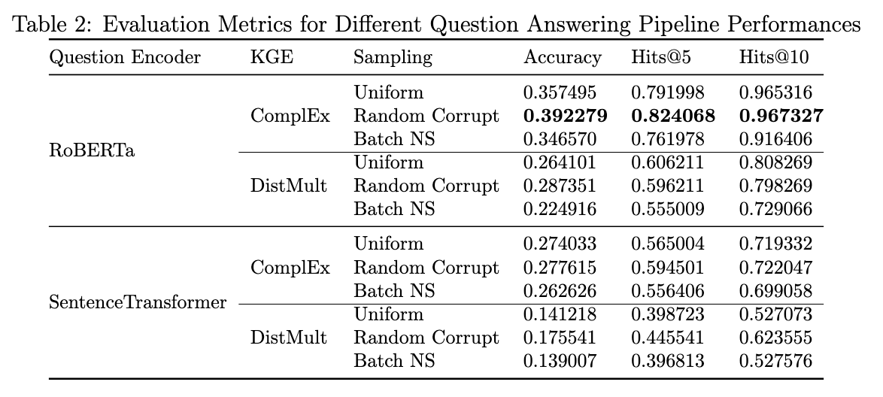
Results: Question Answering
Notes:
oni
This is the result for kgqa system.
"As we see here, RoBERTa significantly outperforms the SentenceTransformer across all metrics."
"ComplEx embeddings with Random Corrupt method have the highest accuracy, clearly outperforming other combinations."
"The top-performing setup, highlighted in red, shows an accuracy of 39.23%, with Hits@5 at 82.41% and Hits@10 nearly reaching 97%. This is a notable improvement over other methods."
"our choice of RoBERTa and ComplEx with Random Corrupt is the best model configuration"

Slide 18
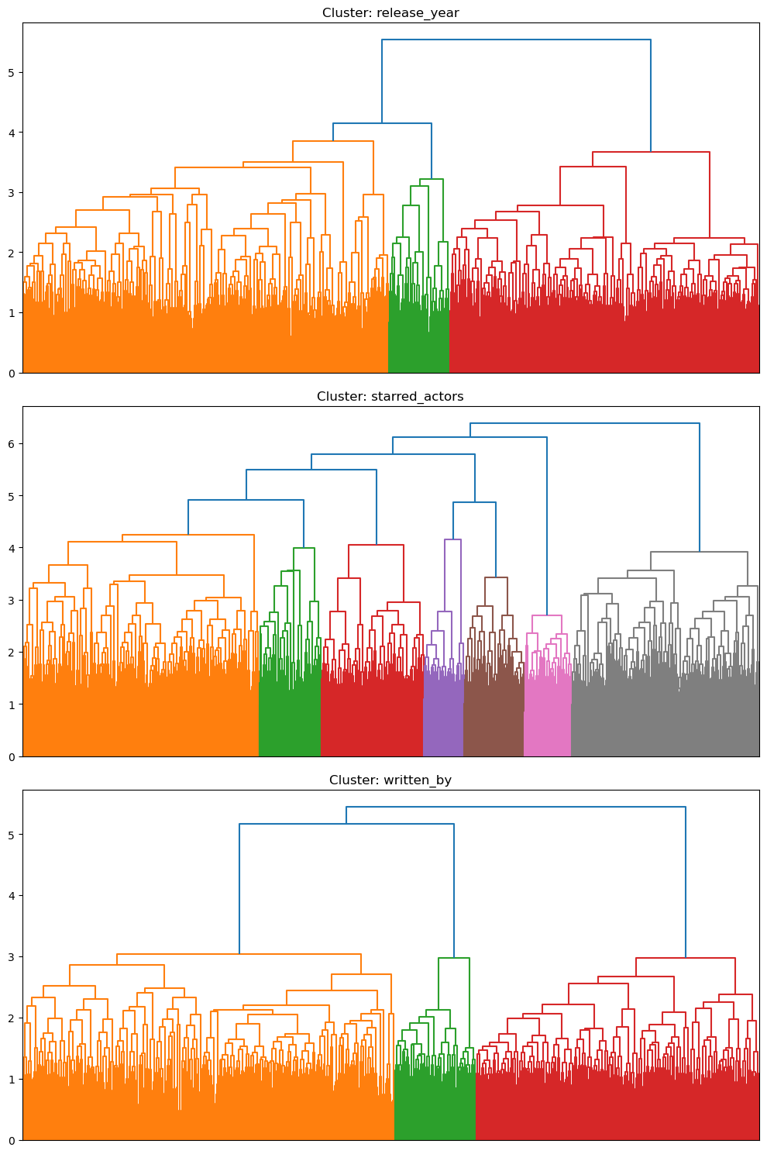
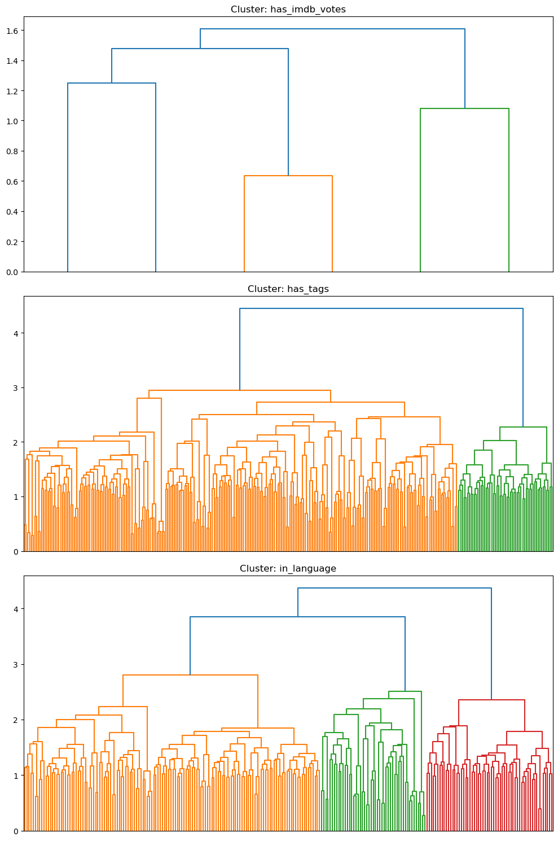
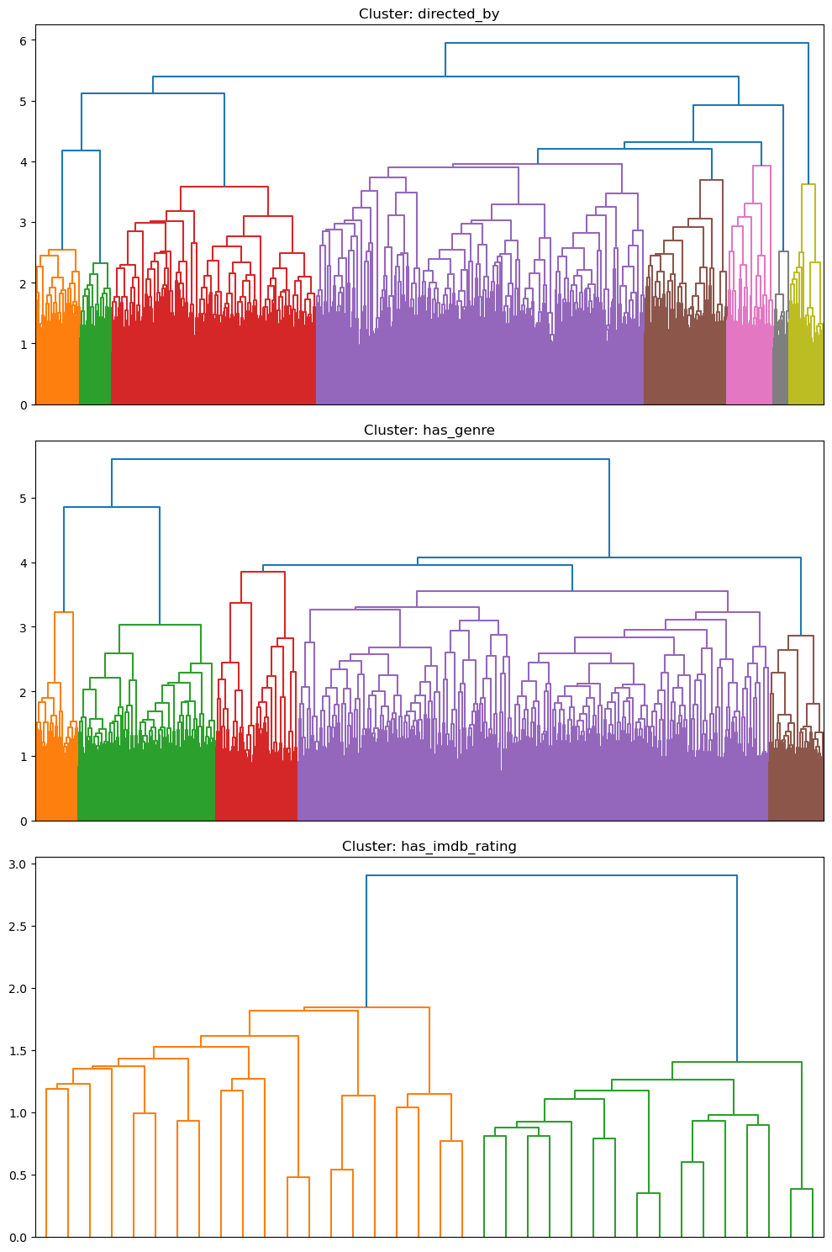
Hierarchical Analysis by Relations
Notes:
Yoni
And this is the extra work.
We did hierarchical clustering on question embeddings by relation type to explore the semantic structure of our knowledge graph.
Usually, all relations divided by 2 or 3 clusters with the longest vertical lines.
As you can see, [year, Actors, writer, Directed, Genre]: These Relations [like 'directed_by'] formed dense clusters, suggesting high semantic similarity among questions.
[Rating, Tag, Language,]: Other relations[, such as 'in_language', ]showed more dispersed clusters, indicating a wider variety of semantics in questions.
Basically, hierarchical clustering have 2 main types which are bottom-up approach and top-down approach. Usually buttom-up approach is more common. So this is started by treating each question as a separate cluster. Each step, algorithm merges two cluster that are closest to each other until all the clusters are merged into one big cluster containing all data points.
To merge clusters, the distance between each pair of clusters is calculated. Among the various methods available to determine this distance, we selected Ward's method. It is known as minimum variance method that looks at the impact of merging two clusters on the total within-cluster variance. When combined, the method merges the two clusters that increase the total within-cluster variance the least.
This is a measure of how spread out the points are within a cluster. A lower within-cluster variance means the points are closer to each other, and therefore, the cluster is more compact.

Slide 19
Conclusion
Key Findings: The study highlights that the ComplEx model, enhanced by Random Corrupt Negative Sampling, outperforms others in terms of Mean Rank, Mean Reciprocal Rank (MRR), and Hits@k.
Impact on KGQA: This combination significantly boosts KGQA performance by effectively capturing complex relational dynamics within knowledge graphs.
Role of Advanced NLP: Incorporating advanced NLP techniques like RoBERTa into the EmbedKGQA pipeline critically enhances question answering accuracy and efficiency.
Strategic Insights:
Optimal Sampling Strategy: Random Corrupt Negative Sampling emerges as the most effective strategy, optimizing the quality of embeddings.
Interplay of Techniques: The choice of negative sampling methods and embedding models plays a crucial role in refining KGQA frameworks, suggesting a targeted approach for future enhancements.
Notes:
Yoni
So our project has systematically explored the influence of various negative sampling techniques on the effectiveness of Knowledge Graph Embeddings (KGEs) within Knowledge Graph Question Answering (KGQA) systems. Our results indicate that the ComplEx model with Random Corrupt Negative Sampling and questions embedding through Roberta delivers the most robust performance. These combination significantly boosts KGQA performance by effectively capturing complex relationships within knowledge graph.

